Slide 1

Credit card data
Here we load our credit card dataset to pandas

Slide 2

Data pre-processing
The provided data is very unbalanced.
So, we are using this method for balancing the data

Slide 3

Data analysis
To understand the various features in dataset.
It helps us to find better model

Slide 4
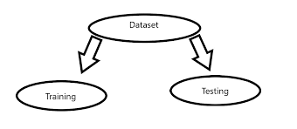
Train – test split
It split data into training and testing data
Feed this training to our machine learning model and evaluate model by testing

Slide 5
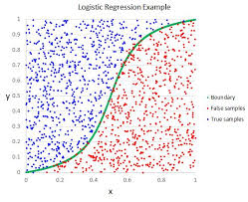
Logistic regression
This is a binary classification model.
We feed training data into logistic regression.
In this we will predict particular transaction is legit or fraud.

Slide 6

Evaluation
We use the testing data to check the performance of our model.

